Slide 1
Week 3: “In the printshops of Ottaviano Petrucci and
Pierre Attaingnant,
ca. 1500-1550”

Slide 2
In the printshops of Petrucci and Attaingnant, ca. 1500-50
What changes come with the printing press? Access to music increases:
Music becomes a business; it can be bought and sold on open market
Music becomes affordable for more people (including amateur market)
Music can be disseminated faster over a wider territory
How do musicians benefit?
Composers can earn money by selling their music to publishers
Composers’ names, music, techniques spread faster and easier
Musicians gain access to a broader range of up-to-date music

Slide 3
In the printshops of Petrucci and Attaingnant, ca. 1500-50
Ottaviano Petrucci (1466-1539): Venetian publisher
First publisher to print polyphonic music, using movable type
Triple-impression: slow but produces precise and visually pleasing scores
Monopoly on music publishing in Venice, ca. 1500-1520
67 volumes of polyphonic music, not including reprints
Franco-Flemish and Italian pieces of present & recent past
Targeted both professional and amateur markets
Good instincts for picking music that sells well
Thus, his catalogue tells us which music was popular

Slide 4
In the printshops of Petrucci and Attaingnant, ca. 1500-50
Ottaviano Petrucci (1466-1539): Venetian publisher
First publisher to print polyphonic music, using moveable type
Triple-impression: slow but produces precise and visually pleasing scores
Monopoly on music publishing in Venice, ca. 1500-1520
What did Petrucci print?
Harmonice Musices Odhecaton (“100 Polyphonic Songs”), 1501
A collection of 96 Franco-Flemish chansons
Proved so popular that two subsequent volumes were printed (Canti B and Canti C), and original reprinted (as Odhecaton A)

Slide 5
In the printshops of Petrucci and Attaingnant, ca. 1500-50
Josquin des Prez (ca. 1450-1521): “the best composer of our time”
Trained at Cambrai cathedral school; may have studied with Ockeghem
Oltremontano: works for duke Sforza in Milan, Papal chapel, duke of Ferrara
Works: 18 Masses, ca. 100 motets, ca. 70 chansons (in French & Italian)
Music circulates in manuscript and in multiple prints (by Petrucci and others)
Numerous copycats and misattributions – i.e., music by Josquin sells
Knows his worth and does not hesitate to trade on his international reputation:
Signs all his manuscripts
Demands outrageous salaries, special privileges (e.g., from Ercole d’Este)

Slide 6
In the printshops of Petrucci and Attaingnant, ca. 1500-50
Josquin des Prez (ca. 1450-1521): “the best composer of our time”
Trained at Cambrai cathedral school; may have studied with Ockeghem
Oltremontano: works for duke Sforza in Milan, Papal chapel, duke of Ferrara
Works: 18 Masses, ca. 100 motets, ca. 70 chansons (in French & Italian)
Josquin’s Masses: both traditional Franco-Flemish and new types
Cantus-firmus Mass (e.g., Missa Hercules dux Ferrariae; L’homme armé x 2)
Plainsong Mass: each movement’s cantus-firmus is a separate chant
Paraphrase Mass: variant of borrowed tune is in all voices via imitation
Imitation or parody Mass: multiple voices of a polyphonic model are used

Slide 7
In the printshops of Petrucci and Attaingnant, ca. 1500-50
Josquin des Prez (ca. 1450-1521): “the best composer of our time”
Trained at Cambrai cathedral school; may have studied with Ockeghem
Oltremontano: works for duke Sforza in Milan, Papal chapel, duke of Ferrara
Works: 18 Masses, ca. 100 motets, ca. 70 chansons (in French & Italian)
Missa L’homme armé super voces musicales
Opens Petrucci’s 1st volume of Josquin’s Masses
Cantus-firmus Mass, setting traditional L’homme armé tune
voces musicales – solmization syllables: ut, re, mi, fa, sol, la
cantus-firmus transposed a step upward in each movement

Slide 8
In the printshops of Petrucci and Attaingnant, ca. 1500-50
Josquin des Prez (ca. 1450-1521): “the best composer of our time”
Trained at Cambrai cathedral school; may have studied with Ockeghem
Oltremontano: works for duke Sforza in Milan, Papal chapel, duke of Ferrara
Works: 18 Masses, ca. 100 motets, ca. 70 chansons (in French & Italian)
Missa L’homme armé super voces musicales
Virtuosic compositional craftsmanship (wrote it to “show off”)
Musical references to:
Antoine Busnois: Burgundian, composed a famous L’homme armé Mass
Johannes Ockeghem: teacher/mentor, known for his superior technique

Slide 9
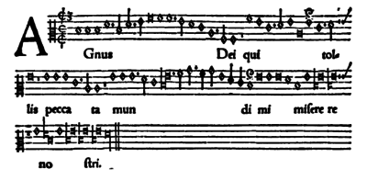
In the printshops of Petrucci and Attaingnant, ca. 1500-50
Josquin des Prez (ca. 1450-1521): “the best composer of our time”
Trained at Cambrai cathedral school; may have studied with Ockeghem
Oltremontano: works for duke Sforza in Milan, Papal chapel, duke of Ferrara
Works: 18 Masses, ca. 100 motets, ca. 70 chansons (in French & Italian)
Missa L’homme armé super voces musicales
Multiple mensuration canons in each movement (inspired by Ockeghem’s legendary Missa Prolationum)
Agnus Dei-II: singers must solve “ex uno voce tres” to create a 3-part mensuration canon (example appears in textbooks)

Slide 10
In the printshops of Petrucci and Attaingnant, ca. 1500-50
Josquin des Prez (ca. 1450-1521): “the best composer of our time”
Trained at Cambrai cathedral school; may have studied with Ockeghem
Oltremontano: works for duke Sforza in Milan, Papal chapel, duke of Ferrara
Works: 18 Masses, ca. 100 motets, ca. 70 chansons (in French & Italian)
Missa L’homme armé super voces musicales
Kyrie: L’homme armé tune (on C) is divided into 3 parts, one per section
In each section, the tune is set in a 2-voice mensuration canon
The cantus-firmus in the tenor is always the slower answering voice
By the movement’s end, L’homme armé has appeared in all 4 voices

Slide 11
In the printshops of Petrucci and Attaingnant, ca. 1500-50
Josquin des Prez (ca. 1450-1521): “the best composer of our time”
Trained at Cambrai cathedral school; may have studied with Ockeghem
Oltremontano: works for duke Sforza in Milan, Papal chapel, duke of Ferrara
Works: 18 Masses, ca. 100 motets, ca. 70 chansons (in French & Italian)
Missa Pange Lingua
Possibly Josquin’s last Mass; not included in Petrucci’s vol. 3 (publ. 1514)
Circulated in manuscript until 1539 (published by Hans Ott of Nuremberg)
4 voices; very consonant and more texturally fluid than Dufay’s (no rigid textural “blocks”; no. of voices constantly changes)

Slide 12
In the printshops of Petrucci and Attaingnant, ca. 1500-50
Josquin des Prez (ca. 1450-1521): “the best composer of our time”
Trained at Cambrai cathedral school; may have studied with Ockeghem
Oltremontano: works for duke Sforza in Milan, Papal chapel, duke of Ferrara
Works: 18 Masses, ca. 100 motets, ca. 70 chansons (in French & Italian)
Missa Pange Lingua
A paraphrase Mass: borrowed melody is melodically varied
Source melody: chant Pange lingua gloriosi
Hymn for Vespers, Feast of Corpus Christi
Text: rhymed poem by St. Thomas Aquinas

Slide 13
In the printshops of Petrucci and Attaingnant, ca. 1500-50
Josquin des Prez (ca. 1450-1521): “the best composer of our time”
Trained at Cambrai cathedral school; may have studied with Ockeghem
Oltremontano: works for duke Sforza in Milan, Papal chapel, duke of Ferrara
Works: 18 Masses, ca. 100 motets, ca. 70 chansons (in French & Italian)
Missa Pange Lingua
Paraphrased hymn melody is:
Used in all 5 movements
Shared between all 4 voices by using imitation

Slide 14
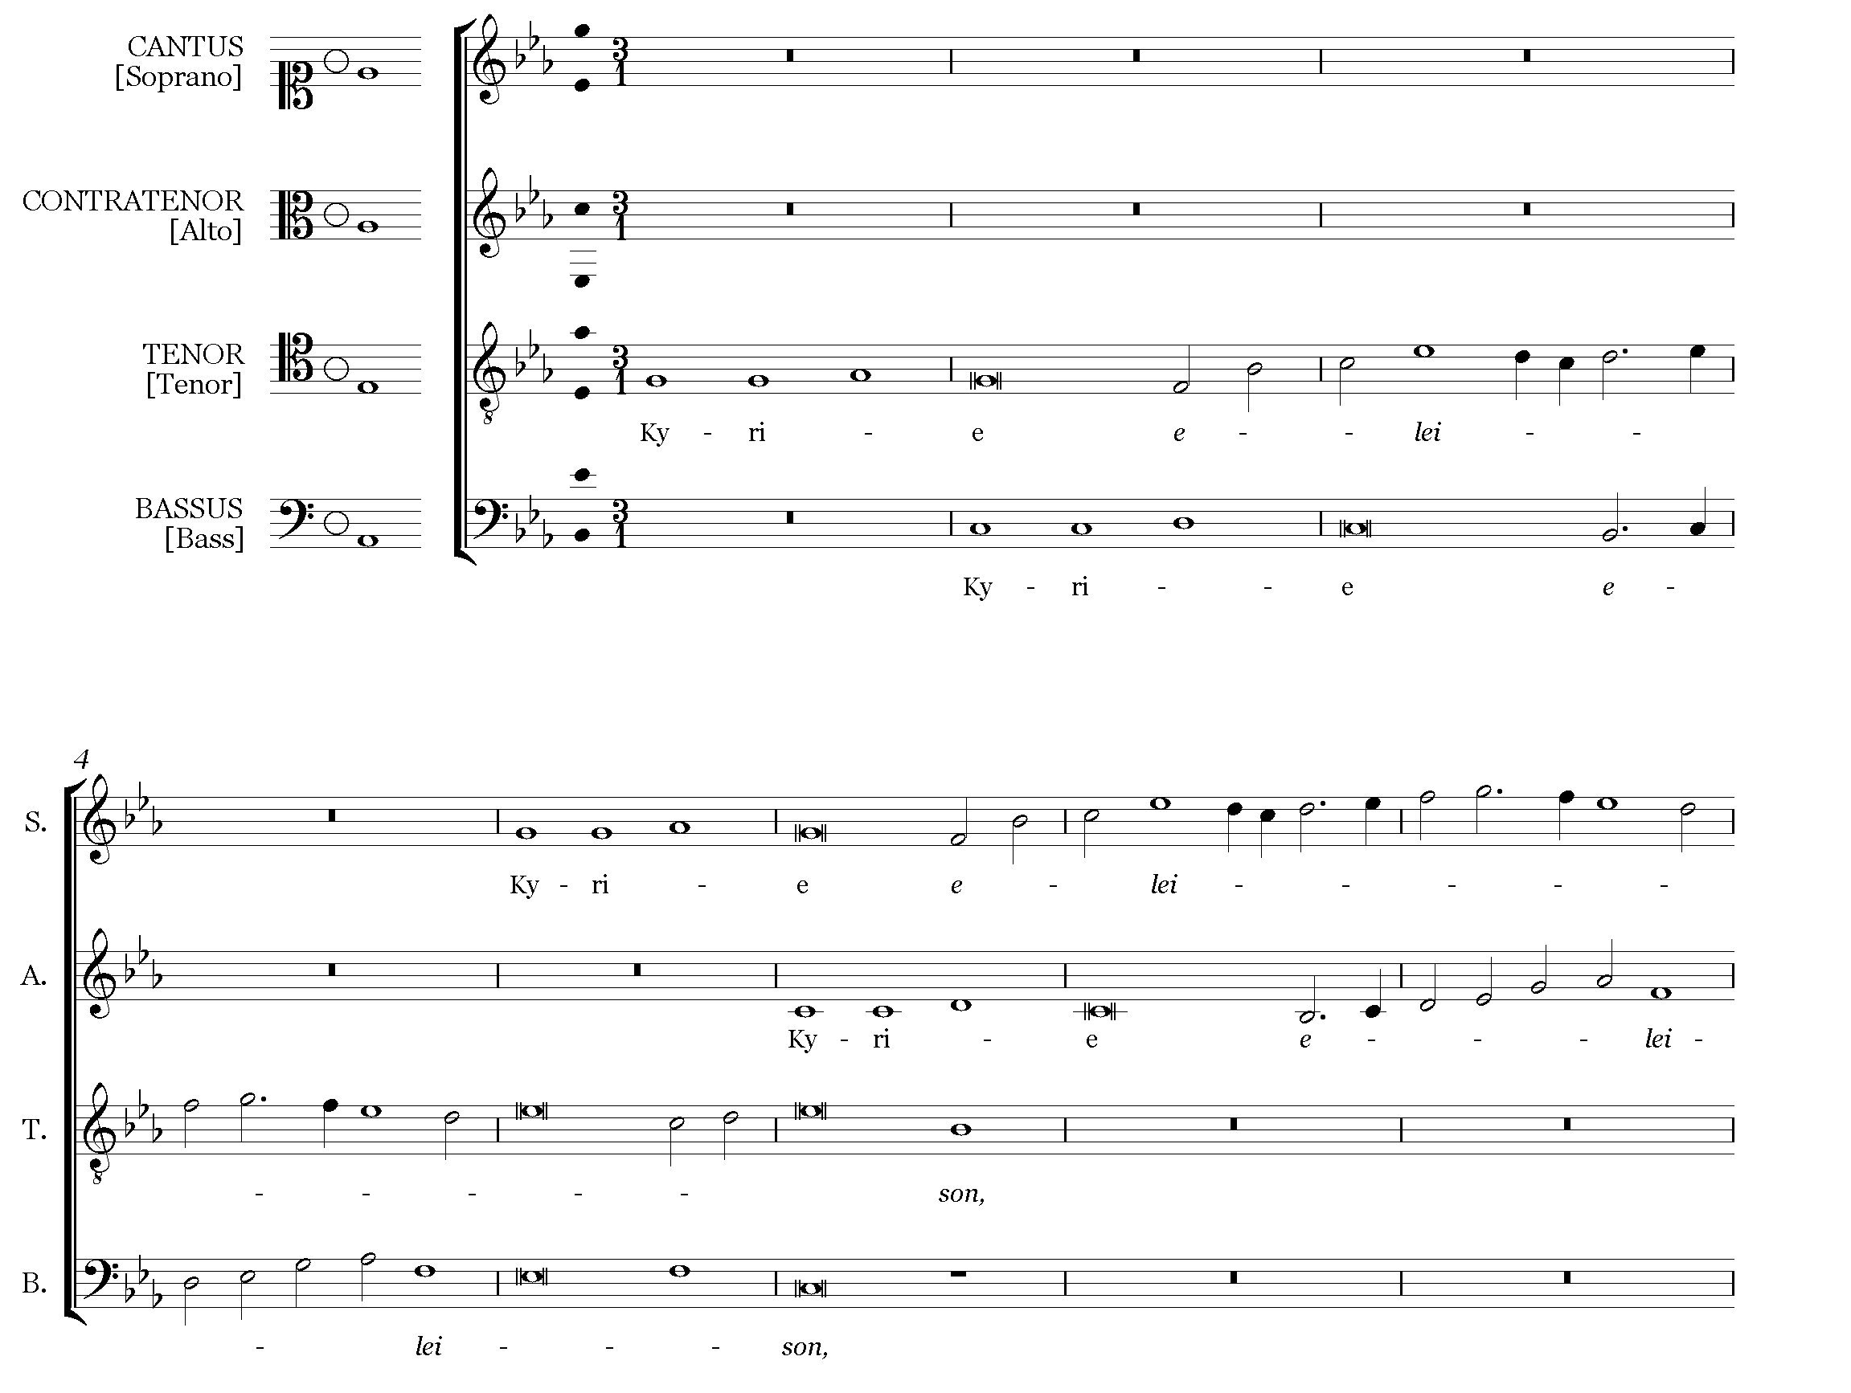
In the printshops of Petrucci and Attaingnant, ca. 1500-50
Josquin des Prez (ca. 1450-1521): “the best composer of our time”
Trained at Cambrai cathedral school; may have studied with Ockeghem
Oltremontano: works for duke Sforza in Milan, Papal chapel, duke of Ferrara
Works: 18 Masses, ca. 100 motets, ca. 70 chansons (in French & Italian)
Missa Pange Lingua: Kyrie
Each phrase of the hymn is a subject for a point of imitation, followed by a ”drive to the cadence,” which ends a section
Each section uses the technique of paired imitation (a pair of voices in imitation is imitated by the other pair of voices)

Slide 15
In the printshops of Petrucci and Attaingnant, ca. 1500-50
Josquin des Prez (ca. 1450-1521): “the best composer of our time”
Trained at Cambrai cathedral school; may have studied with Ockeghem
Oltremontano: works for duke Sforza in Milan, Papal chapel, duke of Ferrara
Works: 18 Masses, ca. 100 motets, ca. 70 chansons (in French & Italian)
Missa Pange Lingua: Kyrie
Pitch sequence C-D-F-E from the hymn, set in Christe: a famous fugue subject (used by Fischer, Froberger, J. S. Bach, Johann Fux, W. A. Mozart)
Featured in textbook Gradus ad Parnassum

Slide 16
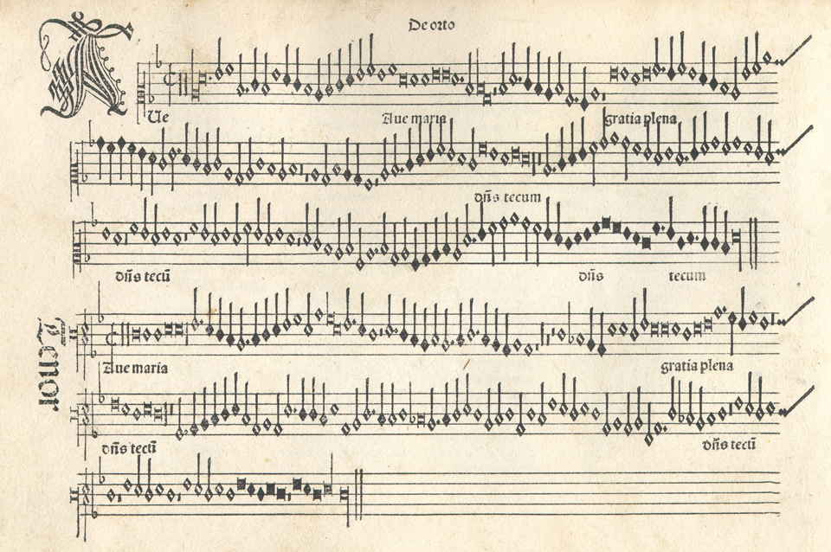
In the printshops of Petrucci and Attaingnant, ca. 1500-50
Josquin des Prez (ca. 1450-1521): “the best composer of our time”
Trained at Cambrai cathedral school; may have studied with Ockeghem
Oltremontano: works for duke Sforza in Milan, Papal chapel, duke of Ferrara
Works: 18 Masses, ca. 100 motets, ca. 70 chansons (in French & Italian)
Ave Maria… virgo serena (ca. 1485)– 4-part motet
Earliest datable Josquin motet (likely for the cappella Sforza)
Opens Petrucci’s first volume of Josquin’s motets (1502)
Multiple reprints and manuscript copies – very popular!

Slide 17
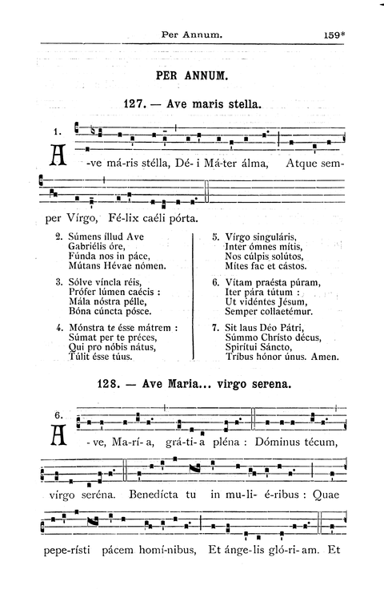
In the printshops of Petrucci and Attaingnant, ca. 1500-50
Josquin des Prez (ca. 1450-1521): “the best composer of our time”
Trained at Cambrai cathedral school; may have studied with Ockeghem
Oltremontano: works for duke Sforza in Milan, Papal chapel, duke of Ferrara
Works: 18 Masses, ca. 100 motets, ca. 70 chansons (in French & Italian)
Ave Maria… virgo serena (ca. 1485)– 4-part motet
Text: a conflation of 3 popular Marian prayers & hymns
Musical source: a chant that sets the opening sequence text for the Feast of Annunciation (a melodic variant from Milan)

Slide 18
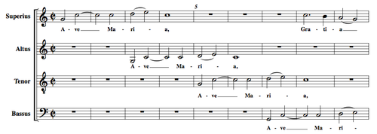
In the printshops of Petrucci and Attaingnant, ca. 1500-50
Josquin des Prez (ca. 1450-1521): “the best composer of our time”
Trained at Cambrai cathedral school; may have studied with Ockeghem
Oltremontano: works for duke Sforza in Milan, Papal chapel, duke of Ferrara
Works: 18 Masses, ca. 100 motets, ca. 70 chansons (in French & Italian)
Ave Maria… virgo serena (ca. 1485)– 4-part motet
Transparent texture, sensitive text setting
Each line of text is set to an individual phrase
Cadences, section ends aligned with the poetry
E.g., the opening: use of syntactic imitation

Slide 19
In the printshops of Petrucci and Attaingnant, ca. 1500-50
Josquin des Prez (ca. 1450-1521): “the best composer of our time”
Trained at Cambrai cathedral school; may have studied with Ockeghem
Oltremontano: works for duke Sforza in Milan, Papal chapel, duke of Ferrara
Works: 18 Masses, ca. 100 motets, ca. 70 chansons (in French & Italian)
Ave Maria… virgo serena (ca. 1485)– 4-part motet
Textures and contrapuntal techniques vary for each couplet & quatrain; include:
Regular and paired imitation (strict and free)
Antiphonal alternation of textural blocks
Homophony and fauxbourdon

Slide 20
In the printshops of Petrucci and Attaingnant, ca. 1500-50
Josquin des Prez (ca. 1450-1521): “the best composer of our time”
Trained at Cambrai cathedral school; may have studied with Ockeghem
Oltremontano: works for duke Sforza in Milan, Papal chapel, duke of Ferrara
Works: 18 Masses, ca. 100 motets, ca. 70 chansons (in French & Italian)
Ave Maria… virgo serena (ca. 1485)– 4-part motet
The chant melody is paraphrased throughout the motet
Not a cantus-firmus: appears in all voices; all voices are of equal structural importance

Slide 21
In the printshops of Petrucci and Attaingnant, ca. 1500-50
Oltremontani composers (like Josquin) dominate Italian music market
Italian composers cannot compete
Ca. 1500: Italian secular music begins to rise in popularity
1504-14: Petrucci prints 11 collections of frottole
Frottola – Italian strophic dance-like song with chordal accompaniment
Court entertainment: semi-popular texts set in a popular style
Not “folk” music: composed & performed by professionals
Developed from a uniquely Italian tradition of improvising epic or lyric poetry, sung to strumming accompaniment (e.g., lute)

Slide 22
In the printshops of Petrucci and Attaingnant, ca. 1500-50
Frottola cultivated from ca. 1490 at the Gonzaga court, duchy of Mantua
Isabella Gonzaga (nee Isabella d’Este) – musician, patron of the arts
Born and educated in Ferrara; studied Franco-Flemish polyphony
Patron and friend to painters, poets, philosophers, composers
Employs Marchetto Cara (d. ca. 1530), lutenist and frottola composer
Frottola – a highly fashionable genre and musical style ca. 1500-1520
Numerous amateurs & professionals attempt to compose them
Petrucci prints rules of frottola composition, lists of suitable poems
Texture (chordal homophony with tune in top voice) influences Franco-Flemish composers

Slide 23
In the printshops of Petrucci and Attaingnant, ca. 1500-50
Frottola cultivated from ca. 1490 at the Gonzaga court, duchy of Mantua
Isabella Gonzaga (née Isabella d’Este) – musician, patron of the arts
Born and educated in Ferrara; studied Franco-Flemish polyphony
Patron and friend to painters, poets, philosophers, composers
Employs Marchetto Cara (d. ca. 1530), lutenist and frottola composer
Io non compro più speranza – a popular frottola by Marchetto Cara
No. 10 in Petrucci’s Primo libro di frottole (1504)
Cantus and tenor only: performer can play the bass line as written (e.g., on a viol) or improvise root-position triads (e.g., on a lute)

Slide 24
In the printshops of Petrucci and Attaingnant, ca. 1500-50
Frottola cultivated from ca. 1490 at the Gonzaga court, duchy of Mantua
Duchess Gonzaga (née Isabella d’Este) – musician, patron of the arts
Born and educated in Ferrara; studied Franco-Flemish polyphony
Patron and friend to painters, poets, philosophers, composers
Employs Marchetto Cara (d. ca. 1530), lutenist and frottola composer
Io non compro più speranza – a popular frottola by Marchetto Cara
Duple & triple rhythms alternate, producing a hemiola effect
Syllabic text setting, with a melisma on penultimate syllable
Poetic/musical structure audible via repetition & clear cadences

Slide 25
In the printshops of Petrucci and Attaingnant, ca. 1500-50
Pierre Attaingnant (1494-1552): Parisian publisher
First publisher to mass-produce polyphonic music, using movable type
Single-impression: fast & cheap (industry standard until 18th century)
“Printer to the King”: monopoly on music publishing
What did Attaingnant print?
Franco-Flemish Masses, motets, and chansons (e.g., by Josquin)
Ca. 1,500 chansons nouvelle (“new songs”), or Parisian chansons
A new French genre, distinct from a Franco-Flemish chanson
As the name suggests, particularly popular in Paris & royal court

Slide 26
In the printshops of Petrucci and Attaingnant, ca. 1500-50
Pierre Attaingnant (1494-1552): Parisian publisher
First publisher to mass-produce polyphonic music, using moveable type
Single-impression: fast & cheap (industry standard until 18th century)
“Printer to the King”: monopoly on music publishing
Chanson nouvelle or Parisian chanson: 16th-century French secular song
Cultivated in the circles of king Francis I & duchess Anne d’Estampes
Light-hearted, often humorous courtly love poetry
Poets: Pierre de Ronsard, Clément Marot

Slide 27
In the printshops of Petrucci and Attaingnant, ca. 1500-50
Pierre Attaingnant (1494-1552): Parisian publisher
First publisher to mass-produce polyphonic music, using moveable type
Single-impression: fast & cheap (industry standard until 18th century)
“Printer to the King”: monopoly on music publishing
Chanson nouvelle or Parisian chanson : 16th-century French secular song
Developed by simplifying Franco-Flemish chanson
Syllabic text setting, with much attention to poetic structure & prosody
Prominent melody; polyphonically animated homophonic texture
Composers: Claudin de Sermisy (1490-1562), Clément Janequin (1485-1560)

Slide 28
In the printshops of Petrucci and Attaingnant, ca. 1500-50
Pierre Attaingnant (1494-1552): Parisian publisher
First publisher to mass-produce polyphonic music, using moveable type
Single-impression: fast & cheap (industry standard until 18th century)
“Printer to the King”: monopoly on music publishing
Tant que vivray: chanson nouvelle by Claudin de Sermisy
Setting of a poem by Clément Marot; published by Attaingnant in 1528
Exceptionally popular (multiple arrangements and reprints)
Syllabic text setting; scrupulous attention to prosody (accents on strong beats; long notes on mid-line caesuras, cadences on punctuation marks)

Slide 29
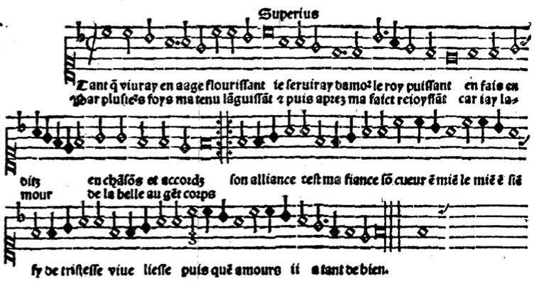
In the printshops of Petrucci and Attaingnant, ca. 1500-50
Pierre Attaingnant (1494-1552): Parisian publisher
First publisher to mass-produce polyphonic music, using moveable type
Single-impression: fast & cheap (industry standard until 18th century)
“Printer to the King”: monopoly on music publishing
Tant que vivray: chanson nouvelle by Claudin de Sermisy
Musical structure reflects poetic structure: 2 sections
A (repeated): slow, longer phrases, homo-rhythmic
B: fast, repetitive, shorter phrases, animated texture
Use of musical rhyme: both A & B end on the same cadence

Slide 30
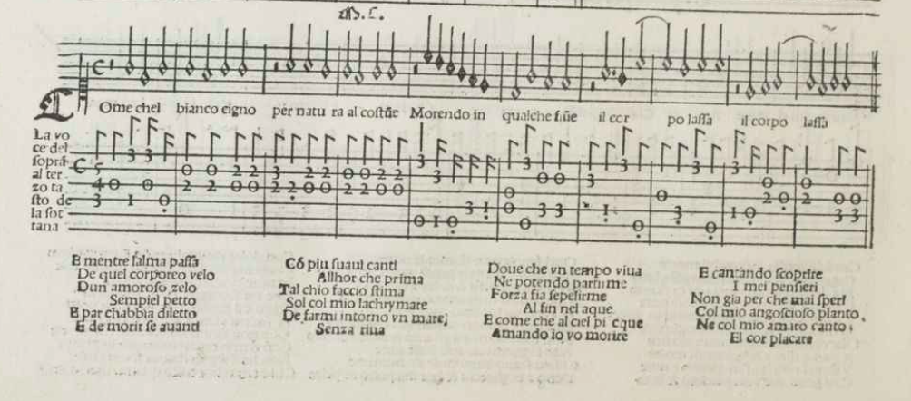
In the printshops of Petrucci and Attaingnant, ca. 1500-50
Pierre Attaingnant (1494-1552): Parisian publisher
Published his own song arrangements and collections of instrumental music
In untexted partbooks (for instrumental ensembles)
In tablature – instrument-specific notation (for lute, keyboard, etc.)

Slide 31
In the printshops of Petrucci and Attaingnant, ca. 1500-50
Pierre Attaingnant (1494-1552): Parisian publisher
Published his own song arrangements and collections of instrumental music
In untexted partbooks (for instrumental ensembles)
In tablature – instrument-specific notation (for lute, keyboard, etc.)
What kind of music did people buy to play on instruments?
Partbooks of (untexted) vocal polyphony
e.g., Petrucci’s Odhecaton A, Canti B-C
Intabulations: instrumental arrangements of vocal music
Idiomatic for the instrument & printed in tablature

Slide 32
In the printshops of Petrucci and Attaingnant, ca. 1500-50
Pierre Attaingnant (1494-1552): Parisian publisher
Published his own song arrangements and collections of instrumental music
In untexted partbooks (for instrumental ensembles)
In tablature – instrument-specific notation (for lute, keyboard, etc.)
What kind of music did people buy to play on instruments?
Dance music (usually for ensemble to accompany dancing)
Printed in partbooks, rather than in tablature
Instrumentation, number of parts unspecified
to allow for maximum flexibility in usage

Slide 33
In the printshops of Petrucci and Attaingnant, ca. 1500-50
Pierre Attaingnant (1494-1552): Parisian publisher
Published his own song arrangements and collections of instrumental music
In untexted partbooks (for instrumental ensembles)
In tablature – instrument-specific notation (for lute, keyboard, etc.)
Attaingnant’s publications of dance music:
Collections of individual dances (e.g., 18 Basse Danses)
Danseries: multiple volumes of dance suites (i.e., sets of 2)
A slower duple-time dance & a faster one in triple-time
e.g., basse danse-branle gay; pavane-galliarde

Slide 34
In the printshops of Petrucci and Attaingnant, ca. 1500-50
Pierre Attaingnant (1494-1552): Parisian publisher
Published his own song arrangements and collections of instrumental music
In untexted partbooks (for instrumental ensembles)
In tablature – instrument-specific notation (for lute, keyboard, etc.)
Pavane 1ere & Galliarde 1ere from 7th book of Danseries
Pavane: a slower stately dance in cut time
Galliarde: a faster dance (with leaps) in triple time
Form follows dance steps (2-mm & 4-mm phrases; repeats)
The set: two variants of the same tune in different meters

